Slide 1

Resolve It Smart Grievance and Feedback Management System
Project Title: “Smart Grievance Management for Healthcare”
by A. Amrutha

Slide 2

Project Overview: Resolve IT
Resolve IT is a smart grievance management system designed for hospital environments. It centralizes all feedback and complaint records, offering a streamlined approach to patient satisfaction.
User Dashboard
Log in and access a personal dashboard to manage interactions.
Submit Grievances
Easily submit complaints related to various hospital services.
Provide Feedback
Offer feedback on experiences to help improve service quality.
Track Status
View real-time status statistics: pending, in-progress, and resolved issues.

Slide 3
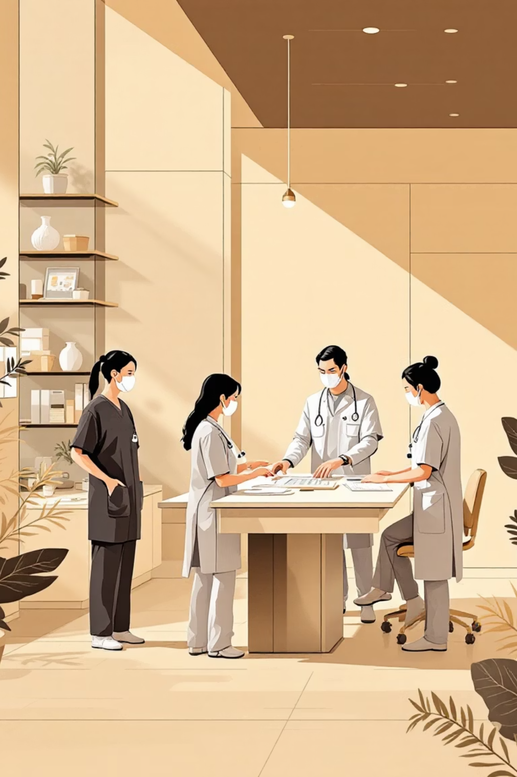




Benefits for Hospitals
The Resolve IT system empowers hospitals to enhance operational efficiency and patient care through digital transformation.
Efficient Digital Records
Maintain all records digitally, reducing paperwork and manual errors.
Reduced Response Delays
Streamline processes to ensure quicker resolution times for complaints.
Improved Patient Satisfaction
Address concerns promptly, leading to a better patient experience.
Enhanced Accountability
Foster greater responsibility among staff and departments.

Slide 4

Proposed Solution: Key Features
Our solution offers a comprehensive web platform designed to manage patient grievances and feedback effectively.
Centralized web platform for submitting patient grievances and feedback.
Secure login system for authenticated user access to dashboards.
Real-time status visibility for all submitted complaints.
Categorization of grievances based on specific hospital departments.
Dedicated feedback module for continuous service quality improvement.
Modern UI using React for a smooth and intuitive user experience.
Scalable architecture for future integration of backend, admin panel, and database.

Slide 5






System Workflow: From Submission to Resolution
The Resolve IT system ensures a clear and efficient process for handling grievances and feedback.
User Logs In
Secure access to the system.
Accesses Dashboard
Personalized overview of interactions.
Submits Grievance/Feedback
Easy submission of concerns.
Admin Reviews
Hospital staff addresses the issue.
Updates Status
Admin provides progress updates.
User Notified
Resolution communicated to the user.

Slide 6

Tech Stack
Resolve IT is built using a robust and modern technology stack to ensure performance, scalability, and a seamless
user experience.
Frontend: HTML, CSS, React
Backend: Java Spring Boot
Database: MySQL
Tools: GitHub, VS Code, Postman

Slide 7


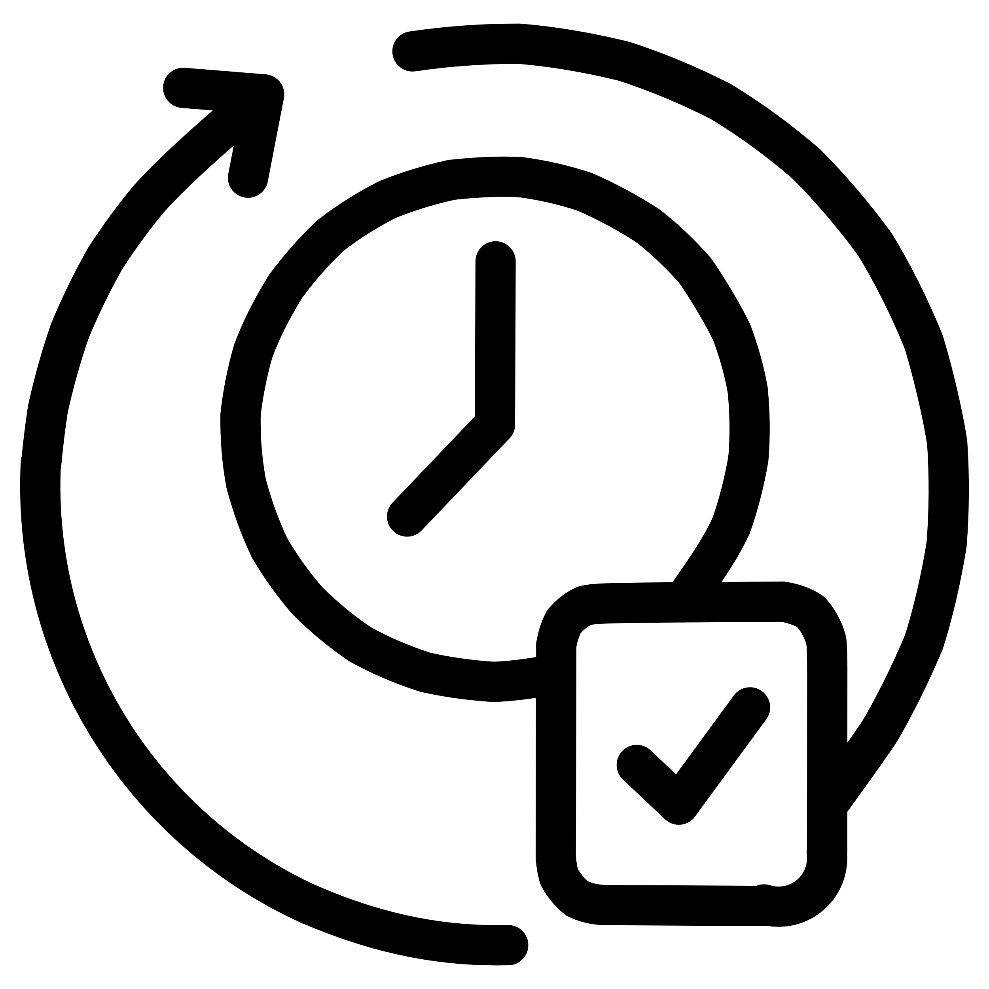


UI/UX Design Principles
Our design philosophy focuses on creating an intuitive and user-friendly interface for all users.
Clean & Modern Interface
Simple Navigation
Consistent Styling
Aesthetically pleasing and easy to navigate.
Clear module tabs for effortless browsing.
Uniform colors and styling for better readability.
Easy Forms
Quick Status Overview
Simplified grievance and feedback submission.
Dashboard designed for immediate complaint status checks.

Slide 8
Feature Document: Current Status
All core UI/UX features for Resolve IT are completed, providing a solid foundation for the system.
Home Page
System overview and CTA buttons
Completed
User Authentication UI
Login & Signup screens
Completed
Dashboard UI
Shows complaint status categories
Completed
Grievance Form
Users can submit complaints
Completed
Feedback Form
Users can submit service feedback
Completed
Navigation & Routing
React Router integration
Completed

Slide 9






Future Development: Expanding Capabilities
Our roadmap includes significant enhancements to further strengthen Resolve IT's functionality and security.
MySQL Database
For secure and scalable data storage.
Spring Boot Backend API
Enabling real-time data handling and processing.
Admin Module
Comprehensive tools for complaint resolution processes.
JWT Authentication
Implementing robust user security measures.
Notifications & Status Updates
Ensuring transparency and continuous communication.
Data Analytics & Reports
Providing insights for informed hospital decision-making.

Slide 10
Advantages of Resolve IT
Resolve IT offers numerous benefits, transforming grievance management into a strategic asset for healthcare providers.
Faster Grievance Registration
Improved Transparency
Streamlined process for quick complaint submission.
Clear visibility into issue resolution status.
Enhanced Communication
Efficient Complaint Tracking
Better interaction between patients and staff.
Hospital management can monitor issues effectively.
Reduced Paperwork & Errors
Increased Patient Satisfaction
Digital system minimizes manual tasks.
Leads to higher quality service and trust.
Secure Data Management
Continuous Improvement
Ensures privacy and integrity of patient information.
Digital records support data-driven decisions.

Slide 11
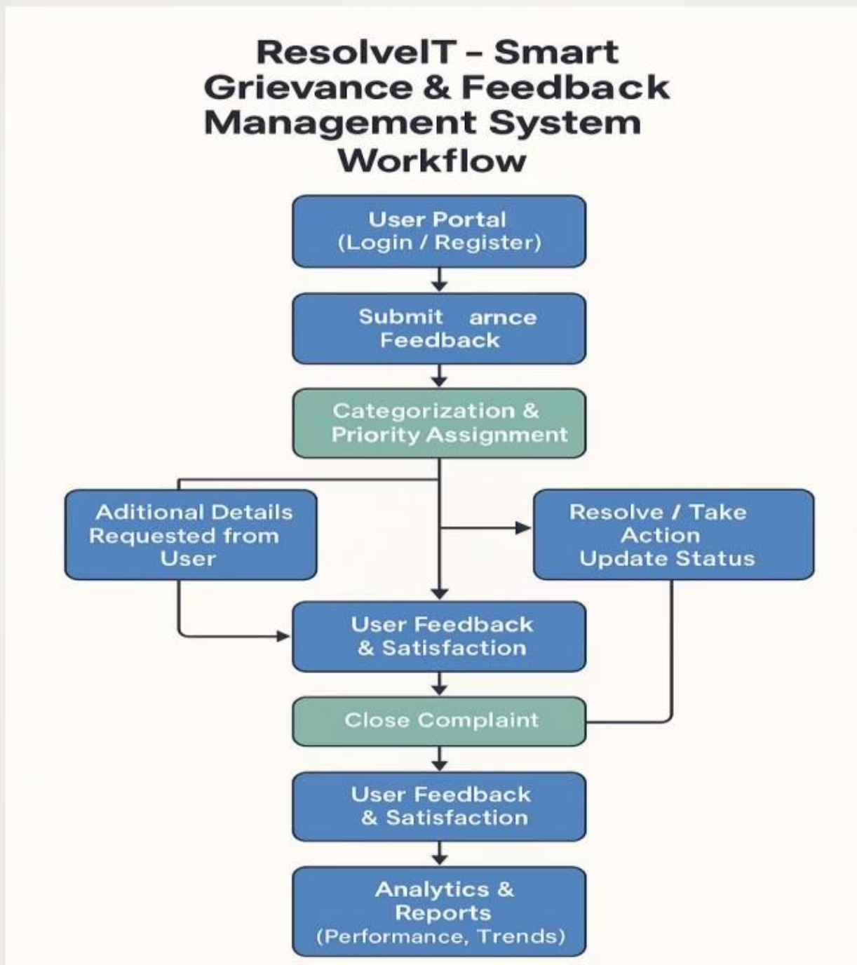
WORKFLOW DIAGRAM
ResolveIT Workflow Diagram
This diagram illustrates the comprehensive workflow of the ResolveIT system, from user submission to complaint resolution and subsequent analytics. It highlights the categorization, priority assignment, and feedback loops essential for continuous improvement.

Slide 12
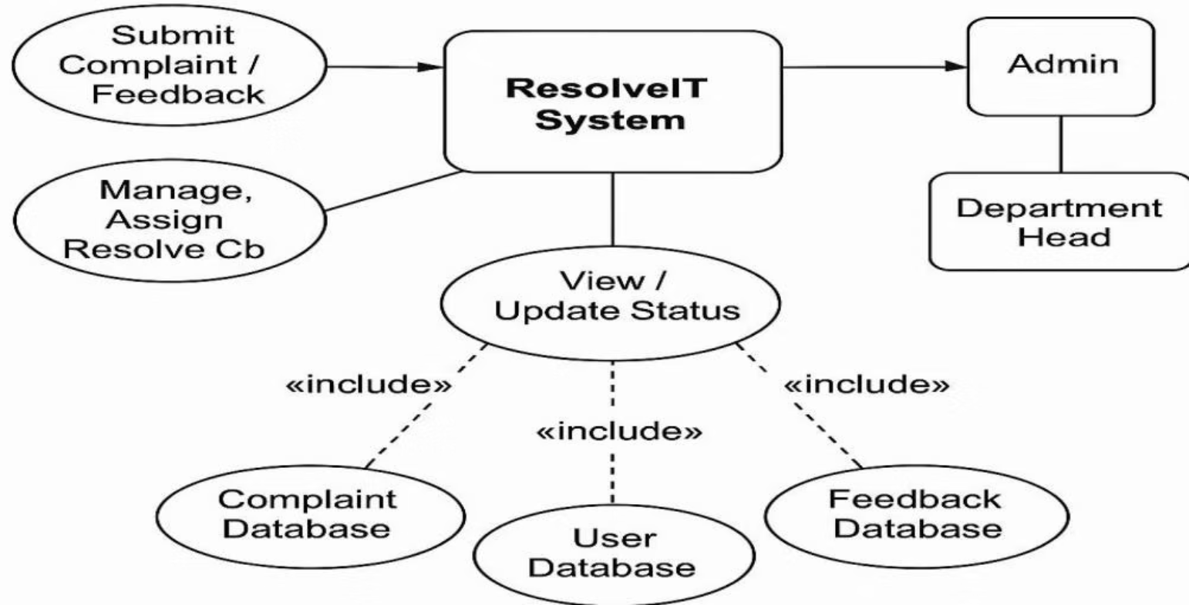
USECASE DIAGRAM
Use Case Diagram
The Use Case Diagram outlines the interactions between various actors (Submit Complaint/Feedback, Admin, Department Head) and the ResolveIT System. It details key use cases such as managing complaints, assigning resolutions, and accessing databases for viewing and updating statuses.

Slide 13
THANK YOU

